Slide 1

Turán-Type Problems
Greg Bodwin
University of Michigan
Frontiers of Graph Algorithms
Turánosaurus

Slide 2
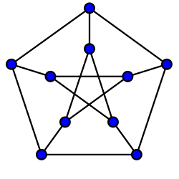
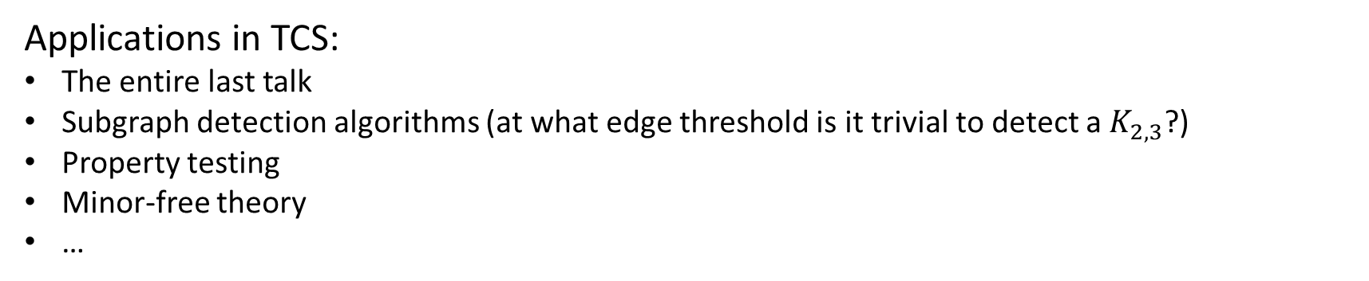
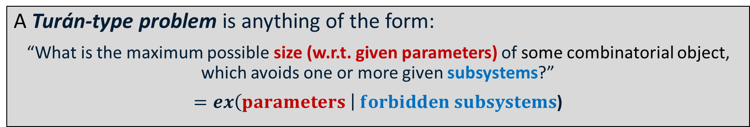
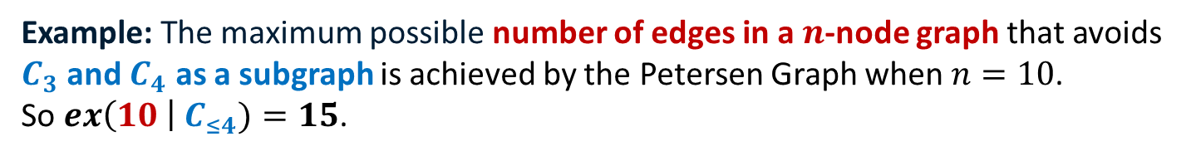
Turán-Type Problems
A Turán-type problem is anything of the form:
“What is the maximum possible size (w.r.t. given parameters) of some combinatorial object, which avoids one or more given subsystems?”
$=ex\left(parameters \right| forbidden subsystems$)
Example: The maximum possible number of edges in a $n$-node graph that avoids $C_{3}$ and $C_{4}$ as a subgraph is achieved by the Petersen Graph when $n=10$.
So $ex\left(10 \right| C_{≤4})=15$.
Applications in TCS:
The entire last talk
Subgraph detection algorithms (at what edge threshold is it trivial to detect a $K_{2, 3}$?)
Property testing
Minor-free theory
…

Slide 3

Part 1: Turán’s Theorem

Slide 4



The Flashlight Problem
You have $6$ batteries, among which $3$ are charged, but you can’t remember which.
Your flashlight turns on iff two charged batteries are inserted.
How many attempts do you need to guarantee that the flashlight turns on?

Slide 5
The Flashlight Problem
You have $6$ batteries, among which $3$ are charged, but you can’t remember which.
Your flashlight turns on iff two charged batteries are inserted.
How many attempts do you need to guarantee that the flashlight turns on?
(example) Do these 8 attempts work?
No: if these are your three charged batteries, then you didn’t test any good pairs.

Slide 6
The Flashlight Problem
You have $6$ batteries, among which $3$ are charged, but you can’t remember which.
Your flashlight turns on iff two charged batteries are inserted.
How many attempts do you need to guarantee that the flashlight turns on?
(example) Do these 8 attempts work?
Yes: for any three batteries, you tried one of the pairs.

Slide 7
The Flashlight Problem
You have $6$ batteries, among which $3$ are charged, but you can’t remember which.
Your flashlight turns on iff two charged batteries are inserted.
How many attempts do you need to guarantee that the flashlight turns on?

Slide 8
The Flashlight Problem
You have $6$ batteries, among which $3$ are charged, but you can’t remember which.
Your flashlight turns on iff two charged batteries are inserted.
How many attempts do you need to guarantee that the flashlight turns on?
Optimal solution is 6
Partition into 2 groups of 3
Try all pairs within each group

Slide 9

The Flashlight Problem
You have $n$ batteries, among which $r$ are charged, but you can’t remember which.
Your flashlight turns on iff two charged batteries are inserted.
How many attempts do you need to guarantee that the flashlight turns on?

Slide 10

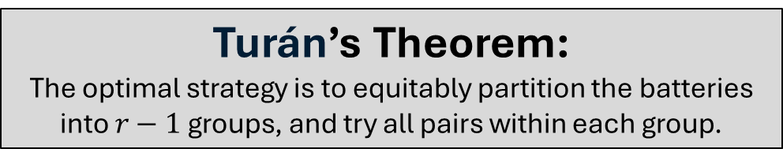
The Flashlight Problem
You have $n$ batteries, among which $r$ are charged, but you can’t remember which.
Your flashlight turns on iff two charged batteries are inserted.
How many attempts do you need to guarantee that the flashlight turns on?
$n=10, r=4$ → opt is 12 attempts
Turán’s Theorem:
The optimal strategy is to equitably partition the batteries into $r−1$ groups, and try all pairs within each group.

Slide 11

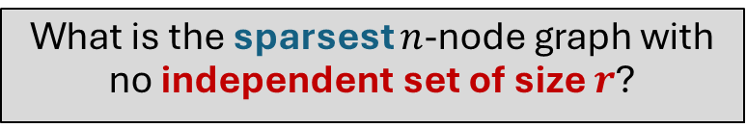
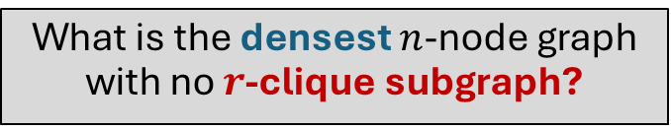
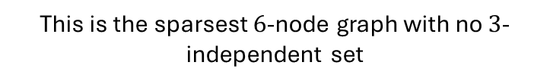
The flashlight problem is really asking …
What is the sparsest $n$-node graph with no independent set of size $r$?
What is the densest $n$-node graph with no $r$-clique subgraph?
This is the sparsest $6$-node graph with no $3$-independent set
The biclique is the densest 6-node graph with no triangle.
complement

Slide 12
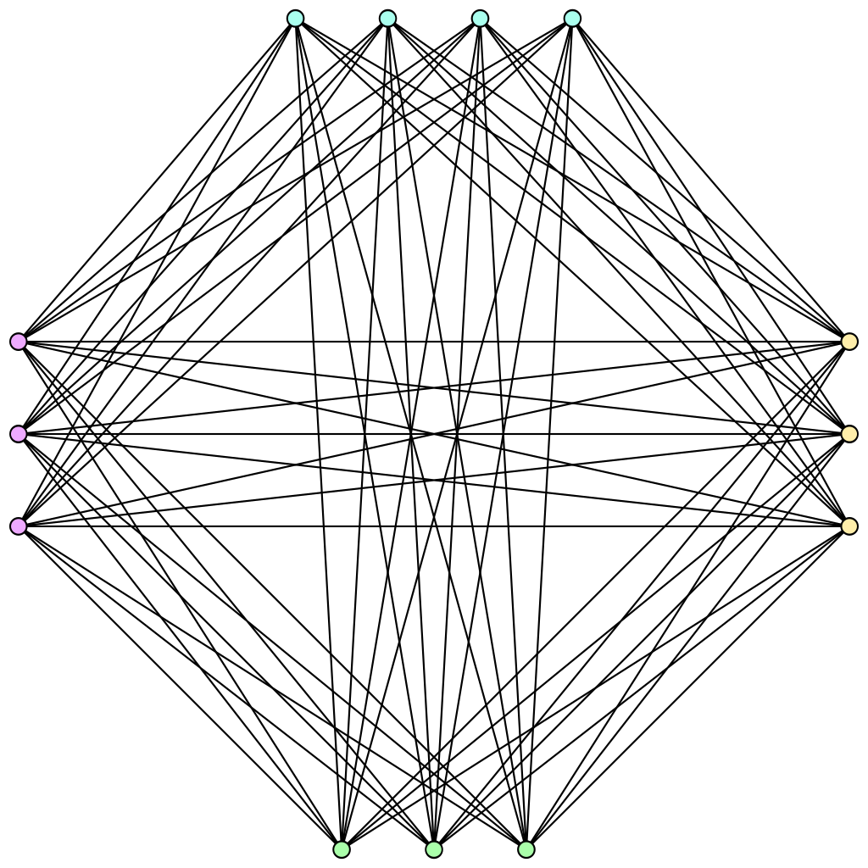
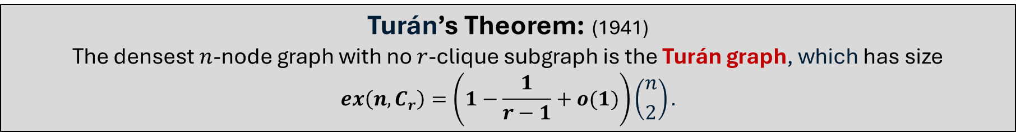

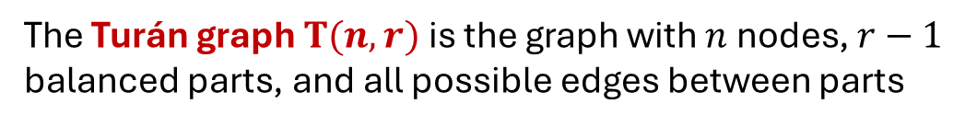
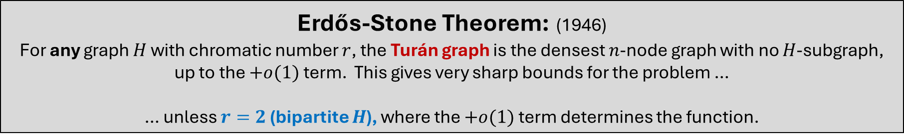
Turán’s Theorem: (1941)
The densest $n$-node graph with no $r$-clique subgraph is the Turán graph, which has size
$$ex\left(n,C_{r}\right)=\left(1−\frac{1}{r−1}+o(1)\right)\left({n \atop 2}\right).$$
The Turán graph $T(n,r)$ is the graph with $n$ nodes, $r−1$ balanced parts, and all possible edges between parts
$$n=13, r=5$$
Erdős-Stone Theorem: (1946)
For any graph $H$ with chromatic number $r$, the Turán graph is the densest $n$-node graph with no $H$-subgraph, up to the $+o(1)$ term. This gives very sharp bounds for the problem …
… unless $r=2$ (bipartite $H$), where the $+o(1)$ term determines the function.

Slide 13
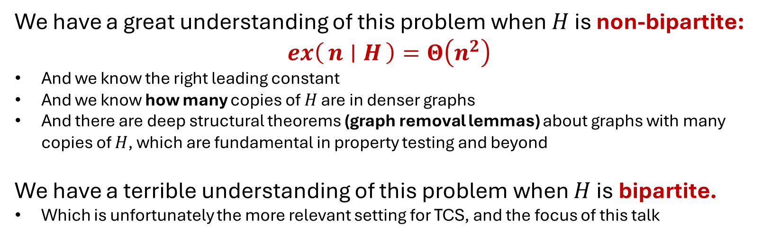
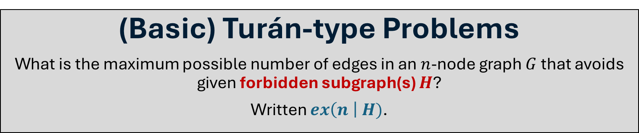
(Basic) Turán-type Problems
What is the maximum possible number of edges in an $n$-node graph $G$ that avoids given forbidden subgraph(s) $H$?
Written $ex\left(n \right| H)$.
We have a great understanding of this problem when $H$ is non-bipartite:
$$ex\left(n ∣ H\right)=Θ\left(n^{2}\right)$$
And we know the right leading constant
And we know how many copies of $H$ are in denser graphs
And there are deep structural theorems (graph removal lemmas) about graphs with many copies of $H$, which are fundamental in property testing and beyond
We have a terrible understanding of this problem when $H$ is bipartite.
Which is unfortunately the more relevant setting for TCS, and the focus of this talk

Slide 14

Part 2: The Moore Bounds

Slide 15

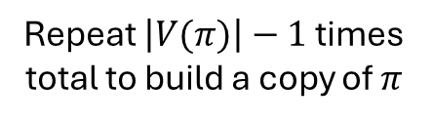
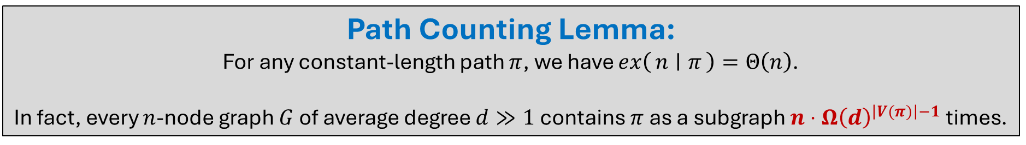
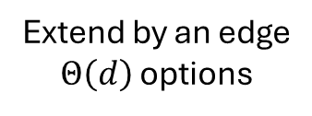
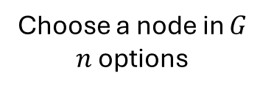
Path Counting Lemma:
For any constant-length path $π$, we have $ex\left(n ∣ π\right)=Θ\left(n\right)$.
In fact, every $n$-node graph $G$ of average degree $d≫1$ contains $π$ as a subgraph $n⋅Ω{\left(d\right)}^{\left|V(π)\right|−1}$ times.
Proof Sketch: Assume that all nodes in $G$ have degree $Θ(d)$.
$$π$$
Choose a node in $G$
$n$ options
Extend by an edge
$Θ\left(d\right)$ options
Repeat $\left|V(π)\right|−1$ times total to build a copy of $π$

Slide 16

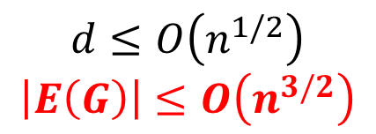
Theorem: (folklore)
Every $n$-node graph $G$ without $C_{4}$ subgraphs has $O\left(n^{3/2}\right)$ edges.
That is, $ex\left(n \right| C_{4})≤O\left(n^{3/2}\right)$.
$G$ cannot have two 2-paths that share endpoints (or else it would have a $C_{4}$ subgraph).
$$n⋅Ω{\left(d\right)}^{2}≤\left(\# simple 2−paths in G\right)≤n^{2}$$
Path Counting Lemma
Pigeonhole Principle
$$d≤O\left(n^{1/2}\right)$$
$$\left|E\left(G\right)\right|≤O\left(n^{3/2}\right)$$

Slide 17

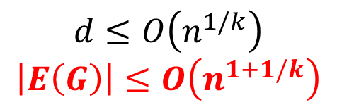
Theorem: (“Moore Bound” – folklore)
Every $n$-node graph $G$ without $C_{≤2k}$ subgraphs has $O\left(n^{1+1/k}\right)$ edges.
That is, $ex\left(n \right| C_{≤2k})≤O\left(n^{1+1/k}\right)$.
$G$ cannot have two simple k-paths that share endpoints (or else it would have a $C_{≤2k}$ subgraph).
$$n⋅Ω{\left(d\right)}^{k}≤\left(\# simple k−paths in G\right)≤n^{2}$$
Path Counting Lemma
Pigeonhole Principle
$$d≤O\left(n^{1/k}\right)$$
$$\left|E\left(G\right)\right|≤O\left(n^{1+1/k}\right)$$

Slide 18
Are the Moore Bounds Tight?
Moore Bound | Tight?

Slide 19
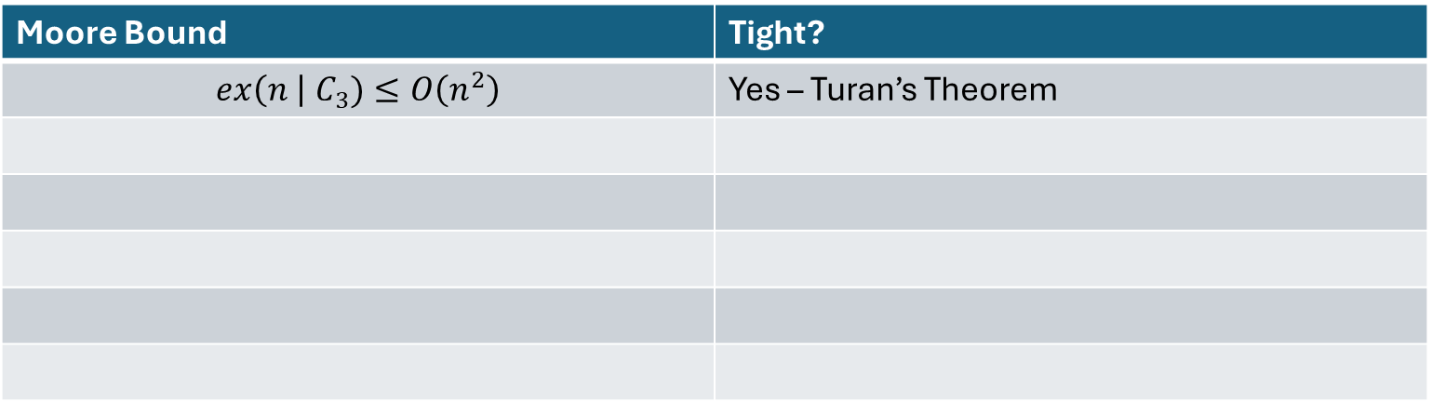
Are the Moore Bounds Tight?
Moore Bound | Tight?
$$ex\left(n \right| C_{3})≤O\left(n^{2}\right)$$ | Yes – Turan’s Theorem

Slide 20
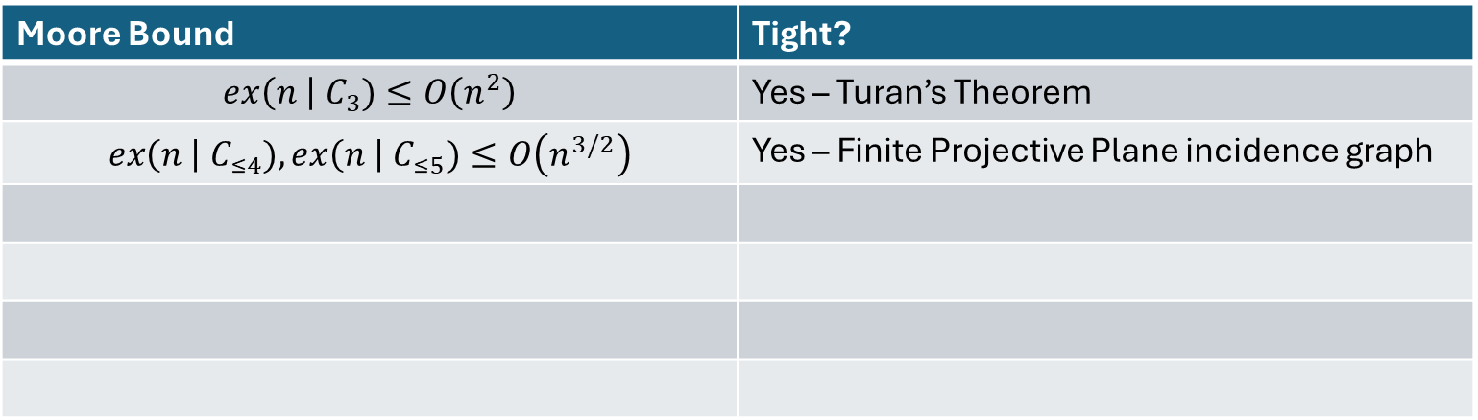
Are the Moore Bounds Tight?
Moore Bound | Tight?
$$ex\left(n \right| C_{3})≤O\left(n^{2}\right)$$ | Yes – Turan’s Theorem
$$ex\left(n \right| C_{≤4}), ex\left(n \right| C_{≤5})≤O\left(n^{3/2}\right)$$ | Yes – Finite Projective Plane incidence graph

Slide 21
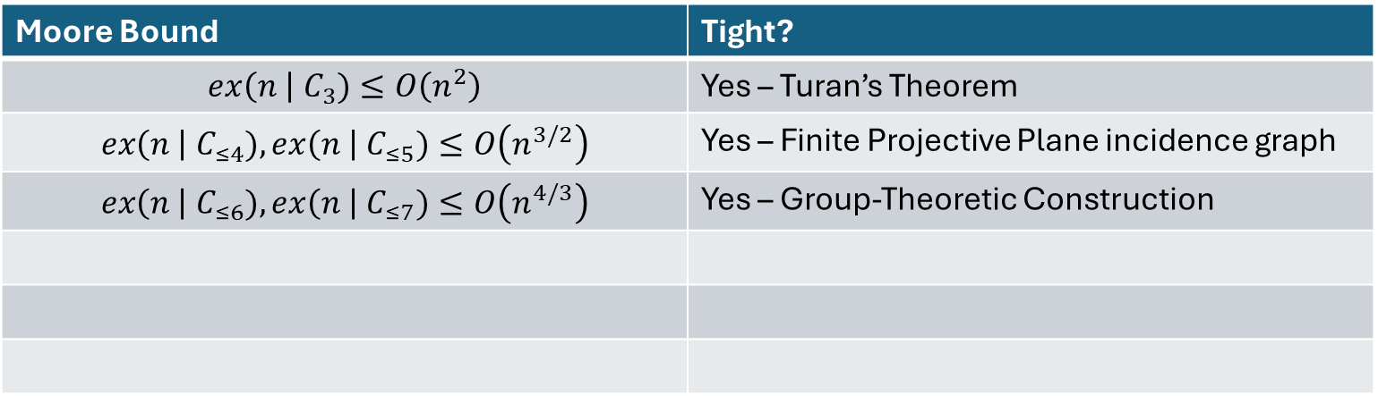
Are the Moore Bounds Tight?
Moore Bound | Tight?
$$ex\left(n \right| C_{3})≤O\left(n^{2}\right)$$ | Yes – Turan’s Theorem
$$ex\left(n \right| C_{≤4}), ex\left(n \right| C_{≤5})≤O\left(n^{3/2}\right)$$ | Yes – Finite Projective Plane incidence graph
$$ex\left(n \right| C_{≤6}),ex\left(n \right| C_{≤7})≤O\left(n^{4/3}\right)$$ | Yes – Group-Theoretic Construction

Slide 22
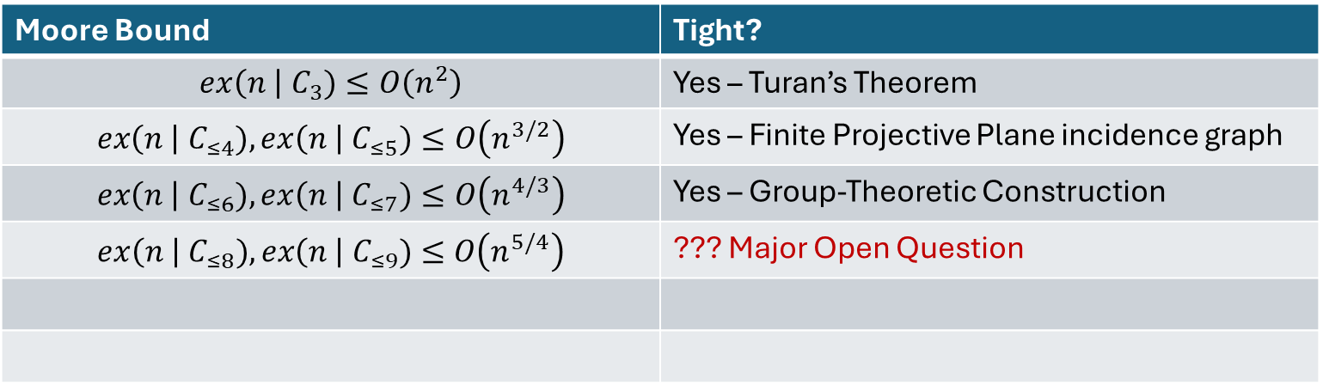
Are the Moore Bounds Tight?
Moore Bound | Tight?
$$ex\left(n \right| C_{3})≤O\left(n^{2}\right)$$ | Yes – Turan’s Theorem
$$ex\left(n \right| C_{≤4}), ex\left(n \right| C_{≤5})≤O\left(n^{3/2}\right)$$ | Yes – Finite Projective Plane incidence graph
$$ex\left(n \right| C_{≤6}),ex\left(n \right| C_{≤7})≤O\left(n^{4/3}\right)$$ | Yes – Group-Theoretic Construction
$$ex\left(n \right| C_{≤8}),ex\left(n \right| C_{≤9})≤O\left(n^{5/4}\right)$$ | ??? Major Open Question

Slide 23
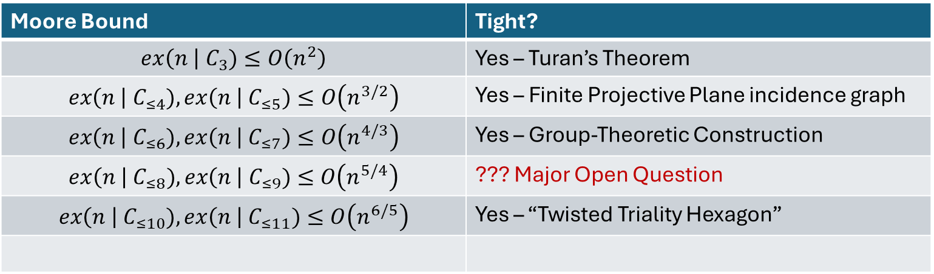
Are the Moore Bounds Tight?
Moore Bound | Tight?
$$ex\left(n \right| C_{3})≤O\left(n^{2}\right)$$ | Yes – Turan’s Theorem
$$ex\left(n \right| C_{≤4}), ex\left(n \right| C_{≤5})≤O\left(n^{3/2}\right)$$ | Yes – Finite Projective Plane incidence graph
$$ex\left(n \right| C_{≤6}),ex\left(n \right| C_{≤7})≤O\left(n^{4/3}\right)$$ | Yes – Group-Theoretic Construction
$$ex\left(n \right| C_{≤8}),ex\left(n \right| C_{≤9})≤O\left(n^{5/4}\right)$$ | ??? Major Open Question
$$ex\left(n \right| C_{≤10}),ex\left(n \right| C_{≤11})≤O\left(n^{6/5}\right)$$ | Yes – “Twisted Triality Hexagon”

Slide 24

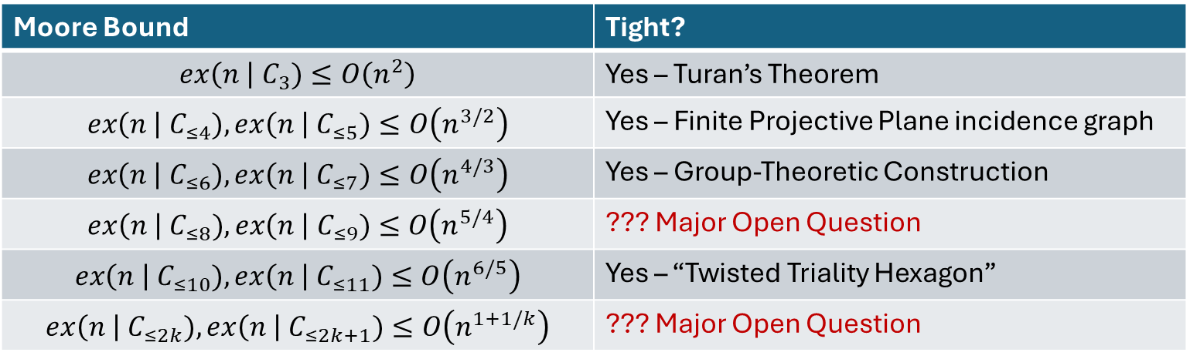
Are the Moore Bounds Tight?
Moore Bound | Tight?
$$ex\left(n \right| C_{3})≤O\left(n^{2}\right)$$ | Yes – Turan’s Theorem
$$ex\left(n \right| C_{≤4}), ex\left(n \right| C_{≤5})≤O\left(n^{3/2}\right)$$ | Yes – Finite Projective Plane incidence graph
$$ex\left(n \right| C_{≤6}),ex\left(n \right| C_{≤7})≤O\left(n^{4/3}\right)$$ | Yes – Group-Theoretic Construction
$$ex\left(n \right| C_{≤8}),ex\left(n \right| C_{≤9})≤O\left(n^{5/4}\right)$$ | ??? Major Open Question
$$ex\left(n \right| C_{≤10}),ex\left(n \right| C_{≤11})≤O\left(n^{6/5}\right)$$ | Yes – “Twisted Triality Hexagon”
$$ex\left(n \right| C_{≤2k}),ex\left(n \right| C_{≤2k+1})≤O\left(n^{1+1/k}\right)$$ | ??? Major Open Question
“The Girth Conjecture:” The Moore Bounds are tight for all $k$.
Very difficult, controversial open problem in TCS and Combinatorics.

Slide 25

Part 3: The Tree-Splitting Method

Slide 26

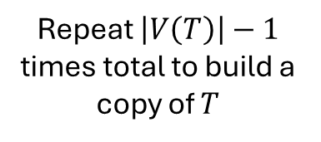
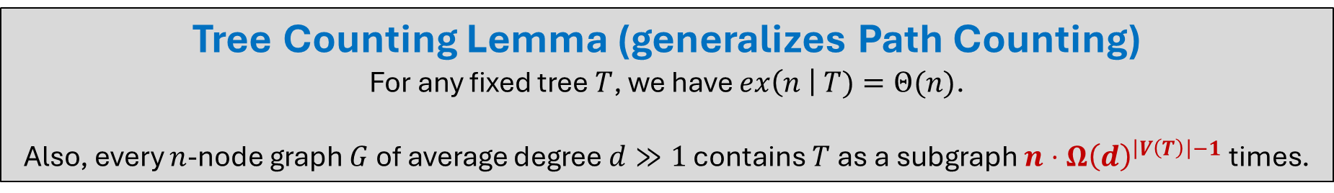
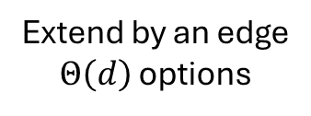
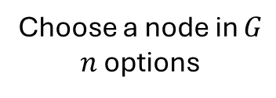
Tree Counting Lemma (generalizes Path Counting)
For any fixed tree $T$, we have $ex\left(n \right| T)=Θ(n)$.
Also, every $n$-node graph $G$ of average degree $d≫1$ contains $T$ as a subgraph $n⋅Ω{\left(d\right)}^{\left|V\left(T\right)\right|−1}$ times.
Proof Sketch: Assume WLOG that all nodes in $G$ have degree $Θ(d)$.
$$T$$
Choose a node in $G$
$n$ options
Extend by an edge
$Θ\left(d\right)$ options
Repeat $\left|V\left(T\right)\right|−1$ times total to build a copy of $T$

Slide 27
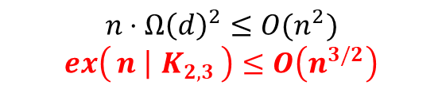

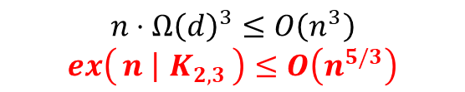
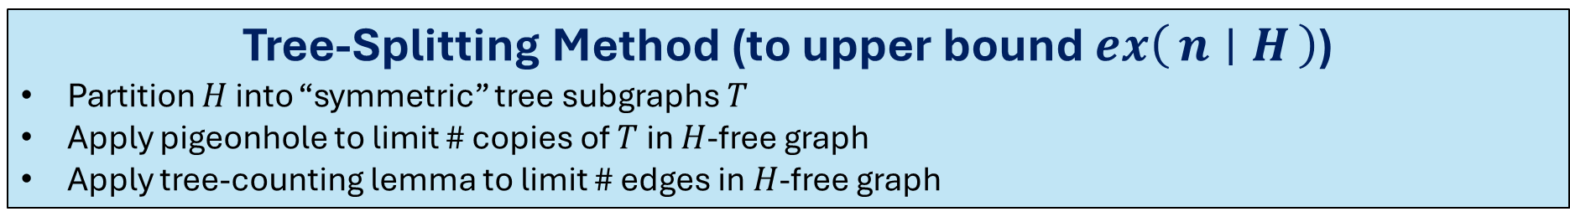
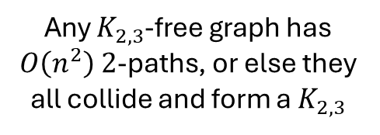
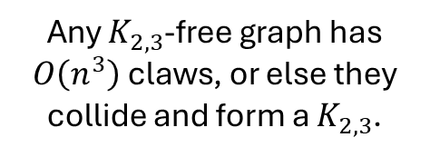
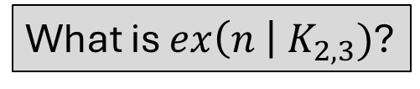
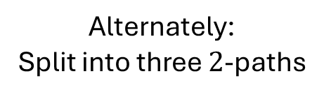

Tree-Splitting Method (to upper bound $ex\left(n ∣ H\right)$)
Partition $H$ into “symmetric” tree subgraphs $T$
Apply pigeonhole to limit # copies of $T$ in $H$-free graph
Apply tree-counting lemma to limit # edges in $H$-free graph
What is $ex\left(n \right| K_{2, 3})$?
Alternately:
Split into three $2$-paths
$$H=K_{2,3}$$
Split into two claws ($K_{1,3}$)
Any $K_{2,3}$-free graph has $O\left(n^{3}\right)$ claws, or else they collide and form a $K_{2,3}$.
Any $K_{2,3}$-free graph has $O\left(n^{2}\right)$ $2$-paths, or else they all collide and form a $K_{2,3}$
$$n⋅Ω{\left(d\right)}^{3}≤O\left(n^{3}\right)$$
$$ex\left(n ∣ K_{2,3}\right)≤O\left(n^{5/3}\right)$$
$$n⋅Ω{\left(d\right)}^{2}≤O(n^{2})$$
$$ex\left(n ∣ K_{2,3}\right)≤O\left(n^{3/2}\right)$$

Slide 28
Tree-Splitting Method (to upper bound $ex\left(n ∣ H\right)$)
Partition $H$ into “symmetric” tree subgraphs $T$
Apply pigeonhole to limit # copies of $T$ in $H$-free graph
Apply tree-counting lemma to limit # edges in $H$-free graph
This is almost the only general technique that is known in the area (if you don’t care about constant factors).
Many graphs have multiple ways to split into trees; one must yield a better bound than the others.

Slide 29
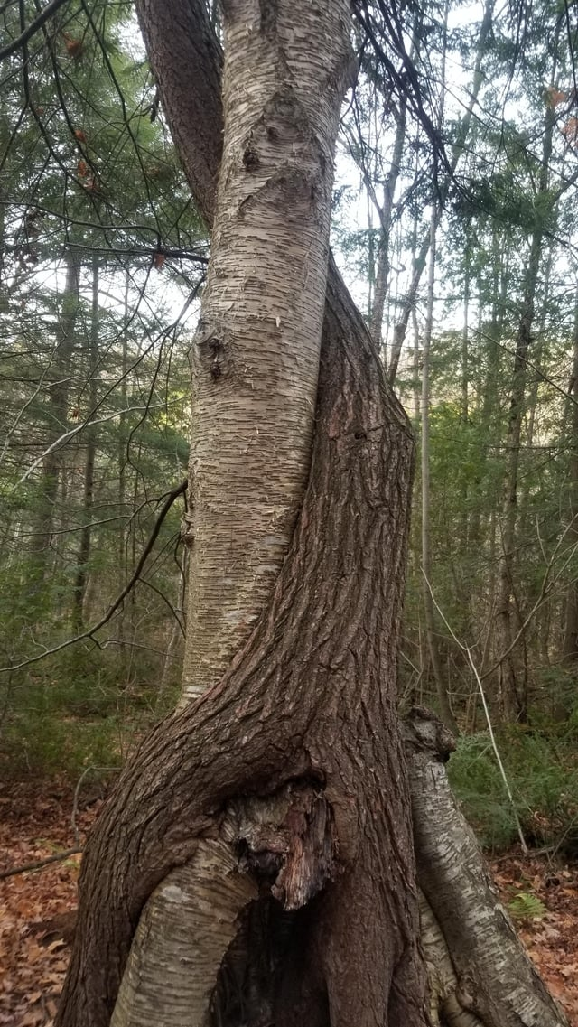
Part 4: Bipartite Turán Problems

Slide 30

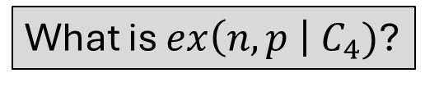

Bipartite Turán Problems
What is $ex\left(n,p \right| C_{4})$?
The strategy of counting 2-paths will work again.
Let $\left|V\right|=n$, $\left|P\right|=p$ be the sides of a graph $G$ without $C_{4}$ subgraphs.
This time, the sides of the bipartite graph lead to two tree-factoring inequalities:
V
(n nodes)
P
(p nodes)
# 2-paths with endpoints in $V$ $≤n^{2}$
Pigeonhole Principle

Slide 31


Bipartite Turán Problems
What is $ex\left(n,p \right| C_{4})$?
The strategy of counting 2-paths will work again.
Let $\left|V\right|=n$, $\left|P\right|=p$ be the sides of a graph $G$ without $C_{4}$ subgraphs.
This time, the sides of the bipartite graph lead to two tree-factoring inequalities:
V
(n nodes)
P
(p nodes)
# 2-paths with endpoints in $V$ $≤n^{2}$
# 2-paths with endpoints in $P$ $≤p^{2}$
Pigeonhole Principle
Pigeonhole Principle

Slide 32
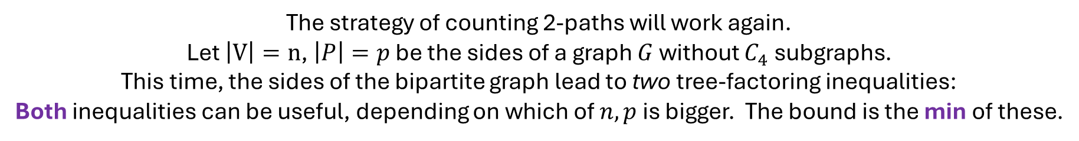


Bipartite Turán Problems
What is $ex\left(n,p \right| C_{4})$?
The strategy of counting 2-paths will work again.
Let $\left|V\right|=n$, $\left|P\right|=p$ be the sides of a graph $G$ without $C_{4}$ subgraphs.
This time, the sides of the bipartite graph lead to two tree-factoring inequalities:
Both inequalities can be useful, depending on which of $n,p$ is bigger. The bound is the min of these.
V
(n nodes)
P
(p nodes)
# 2-paths with endpoints in $V$ $≤n^{2}$
# 2-paths with endpoints in $P$ $≤p^{2}$
(algebra omitted)
(algebra omitted)
$$ex\left(n,p \right| C_{4})≤O(np^{1/2}+p)$$
$$ex\left(n,p \right| C_{4})≤O(n^{1/2}p+n)$$

Slide 33
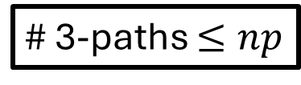
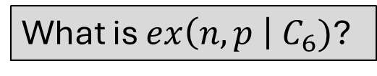

Bipartite Turán Problems
What is $ex\left(n,p \right| C_{6})$?
The strategy of counting 3-paths will work again.
Since 3-paths start and end on different sides, there is only one tree-factoring inequality.
# 3-paths $≤np$
V
(n nodes)
P
(p nodes)
(algebra omitted)
$$ex\left(n,p \right| C_{≤6})≤O(n^{2/3}p^{2/3}+n+p)$$

Slide 34
Are the Bipartite Moore Bounds Tight?
Moore Bound | Tight?

Slide 35
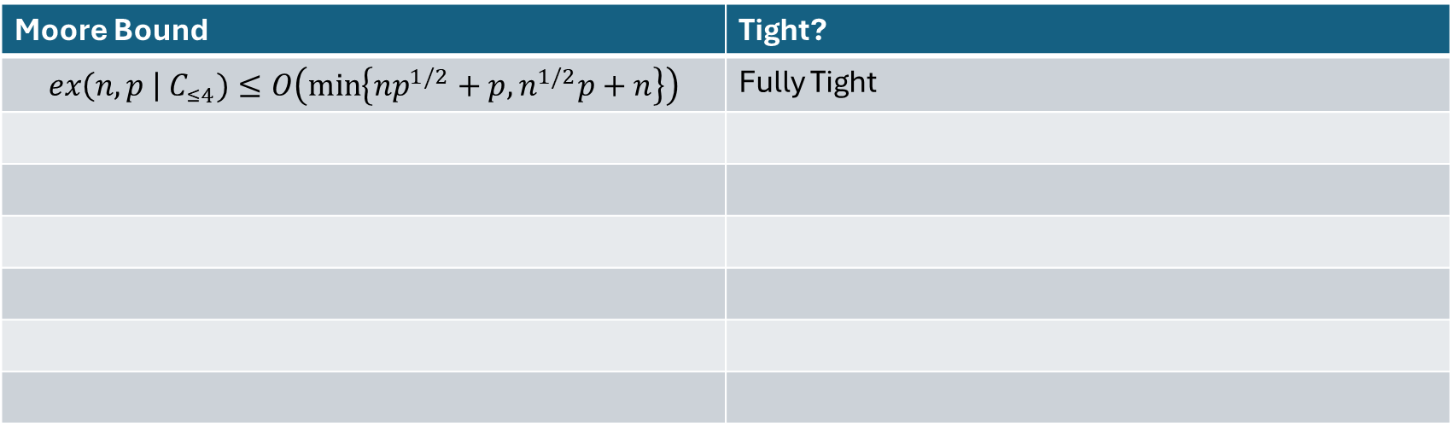
Are the Bipartite Moore Bounds Tight?
Moore Bound | Tight?
$$ex\left(n,p \right| C_{≤4})≤O\left(\min\left\{np^{1/2}+p,n^{1/2}p+n\right\}\right)$$ | Fully Tight

Slide 36
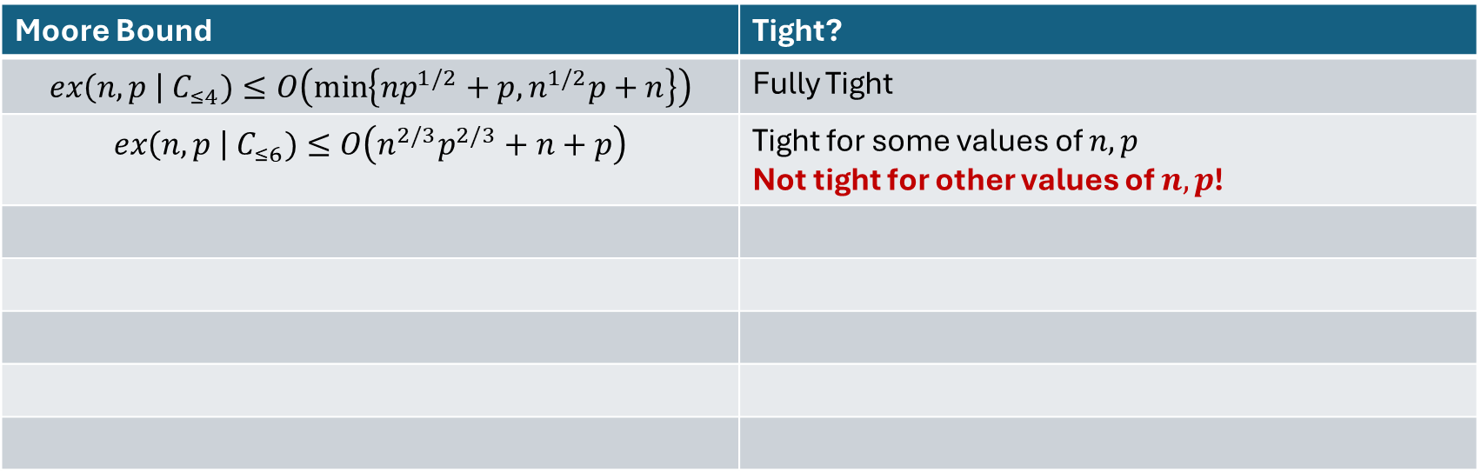
Are the Bipartite Moore Bounds Tight?
Moore Bound | Tight?
$$ex\left(n,p \right| C_{≤4})≤O\left(\min\left\{np^{1/2}+p,n^{1/2}p+n\right\}\right)$$ | Fully Tight
$$ex\left(n,p \right| C_{≤6})≤O\left(n^{2/3}p^{2/3}+n+p\right)$$ | Tight for some values of $n,p$ Not tight for other values of $n,p$!

Slide 37
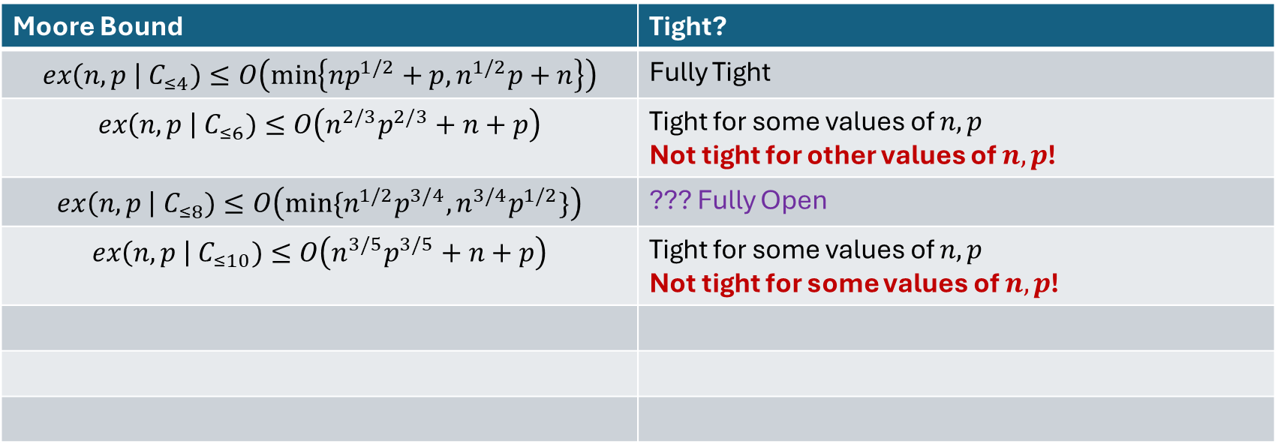
Are the Bipartite Moore Bounds Tight?
Moore Bound | Tight?
$$ex\left(n,p \right| C_{≤4})≤O\left(\min\left\{np^{1/2}+p,n^{1/2}p+n\right\}\right)$$ | Fully Tight
$$ex\left(n,p \right| C_{≤6})≤O\left(n^{2/3}p^{2/3}+n+p\right)$$ | Tight for some values of $n,p$ Not tight for other values of $n,p$!
$$ex\left(n,p \right| C_{≤8})≤O\left(min⁡\{n^{1/2}p^{3/4},n^{3/4}p^{1/2}\}\right)$$ | ??? Fully Open
$$ex\left(n,p \right| C_{≤10})≤O\left(n^{3/5}p^{3/5}+n+p\right)$$ | Tight for some values of $n,p$ Not tight for some values of $n,p$!

Slide 38
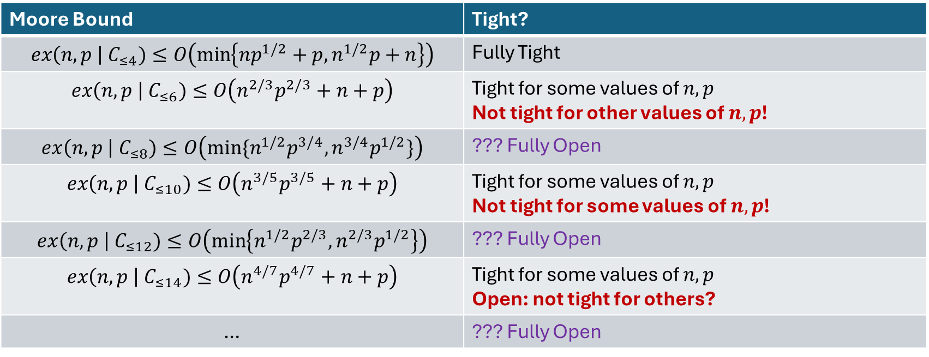
Are the Bipartite Moore Bounds Tight?
Moore Bound | Tight?
$$ex\left(n,p \right| C_{≤4})≤O\left(\min\left\{np^{1/2}+p,n^{1/2}p+n\right\}\right)$$ | Fully Tight
$$ex\left(n,p \right| C_{≤6})≤O\left(n^{2/3}p^{2/3}+n+p\right)$$ | Tight for some values of $n,p$ Not tight for other values of $n,p$!
$$ex\left(n,p \right| C_{≤8})≤O\left(min⁡\{n^{1/2}p^{3/4},n^{3/4}p^{1/2}\}\right)$$ | ??? Fully Open
$$ex\left(n,p \right| C_{≤10})≤O\left(n^{3/5}p^{3/5}+n+p\right)$$ | Tight for some values of $n,p$ Not tight for some values of $n,p$!
$$ex\left(n,p \right| C_{≤12})≤O\left(\min\left\{n^{1/2}p^{2/3},n^{2/3}p^{1/2}\right\}\right)$$ | ??? Fully Open
$$ex\left(n,p \right| C_{≤14})≤O\left(n^{4/7}p^{4/7}+n+p\right)$$ | Tight for some values of $n,p$ Open: not tight for others?
… | ??? Fully Open
“The Bipartite Girth Problem:” For which values of $n,p,k$ can we prove that the Bipartite Moore Bounds are tight, or find better bounds?

Slide 39
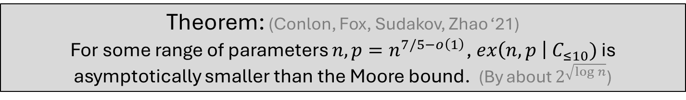
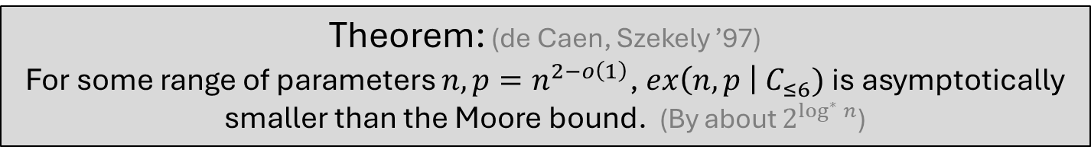
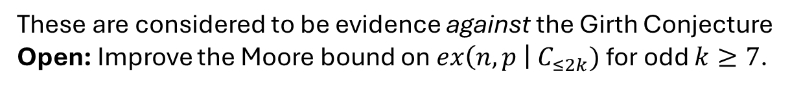
Are the Bipartite Moore Bounds Tight?
Theorem: (de Caen, Szekely ’97)
For some range of parameters $n,p=n^{2−o\left(1\right)}$, $ex\left(n,p \right| C_{≤6})$ is asymptotically smaller than the Moore bound. (By about $2^{\log^{∗}{n}}$)
The proof is by reduction to the Ruzsa-Szemeredi Theorem, covered next
Theorem: (Conlon, Fox, Sudakov, Zhao ‘21)
For some range of parameters $n,p=n^{7/5−o\left(1\right)}$, $ex\left(n,p \right| C_{≤10})$ is asymptotically smaller than the Moore bound. (By about $2^{\sqrt{log n}}$)
These are considered to be evidence against the Girth Conjecture
Open: Improve the Moore bound on $ex\left(n,p \right| C_{≤2k})$ for odd $k≥7$.

Slide 40

Part 5:
The Ruzsa-Szeméredi Theorem

Slide 41

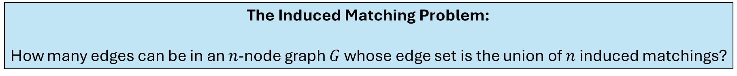

The Induced Matching Problem:
How many edges can be in an $n$-node graph $G$ whose edge set is the union of $n$ induced matchings?
Induced matching = matching that is also an induced subgraph
Trivial Bound: There are $n$ matchings, of size $O(n)$ each, so $\left|E\left(G\right)\right|≤O\left(n^{2}\right)$
Ruzsa-Szemeredi Theorem: (1976)
Actually, $\left|E\left(G\right)\right|≤O\left(\frac{n^{2}}{\log^{∗}{n}}\right)$.
Proof by reduction to the Szemeredi Regularity Lemma.
Fox (2010) improved to $\left|E\left(G\right)\right|≤O\left(\frac{n^{2}}{2^{\log^{∗}{n}}}\right)$

Slide 42


The Induced Matching Problem:
How many edges can be in an $n$-node graph $G$ whose edge set is the union of $n$ induced matchings?
Induced matching = matching that is also an induced subgraph
Ruzsa-Szemeredi Theorem: (1976)
Actually, $\left|E\left(G\right)\right|≤o\left(n^{2}\right)$.
Theorem: (de Caen-Székely ’91)
$\text{The} \text{max} \text{possible} \text{size} \text{of}$|E(G)|$\text{is} \text{the} \text{same} \text{as} \text{the} \text{max} m \text{for} \text{which} ex\left(m,n ∣ C_{≤6}\right)≤3m\text{.}$
Equivalent to special case of bipartite Turán problem!

Slide 43





The Induced Matching Problem:
How many edges can be in an $n$-node graph $G$ whose edge set is the union of $n$ induced matchings?
Theorem: (de Caen-Székely ’91)
$\text{The} \text{max} \text{possible} \text{size} \text{of}$|E(G)|$\text{is} \text{the} \text{same} \text{as} \text{the} \text{max} m \text{for} \text{which} ex\left(m,n ∣ C_{≤6}\right)≤3m\text{.}$
Proof Sketch:
Given an $n$-node, $m$-edge graph $G$ whose edge set is the union of $n$ induced matchings, goal is to construct an auxiliary bipartite graph $G′$ with $m×n$ nodes, $3m$ edges, and no $C_{≤6}$.
Create a new node $v_{M}$ for each induced matching $M$
$$M$$
$$v_{M}$$

Slide 44


The Induced Matching Problem:
How many edges can be in an $n$-node graph $G$ whose edge set is the union of $n$ induced matchings?
Theorem: (de Caen-Székely ’91)
$\text{The} \text{max} \text{possible} \text{size} \text{of}$|E(G)|$\text{is} \text{the} \text{same} \text{as} \text{the} \text{max} m \text{for} \text{which} ex\left(m,n ∣ C_{≤6}\right)≤3m\text{.}$
Proof Sketch:
Given an $n$-node, $m$-edge graph $G$ whose edge set is the union of $n$ induced matchings, goal is to construct an auxiliary bipartite graph $G′$ with $m×n$ nodes, $3m$ edges, and no $C_{≤6}$.
Create a new node $v_{M}$ for each induced matching $M$
Replace each edge $(u,v)∈M$ with a new node connected to $u,v,v_{M}$.
$$x$$
$$v_{M}$$

Slide 45

The Induced Matching Problem:
How many edges can be in an $n$-node graph $G$ whose edge set is the union of $n$ induced matchings?
Theorem: (de Caen-Székely ’91)
$\text{The} \text{max} \text{possible} \text{size} \text{of}$|E(G)|$\text{is} \text{the} \text{same} \text{as} \text{the} \text{max} m \text{for} \text{which} ex\left(m,n ∣ C_{≤6}\right)≤3m\text{.}$
Proof Sketch:
Given an $n$-node, $m$-edge graph $G$ whose edge set is the union of $n$ induced matchings, goal is to construct an auxiliary bipartite graph $G′$ with $m×n$ nodes, $3m$ edges, and no $C_{≤6}$.
Create a new node $v_{M}$ for each induced matching $M$
Replace each edge $(u,v)∈M$ with a new node connected to $u,v,v_{M}$.
$$x$$
$$v_{M}$$

Slide 46

The Induced Matching Problem:
How many edges can be in an $n$-node graph $G$ whose edge set is the union of $n$ induced matchings?
Theorem: (de Caen-Székely ’91)
$\text{The} \text{max} \text{possible} \text{size} \text{of}$|E(G)|$\text{is} \text{the} \text{same} \text{as} \text{the} \text{max} m \text{for} \text{which} ex\left(m,n ∣ C_{≤6}\right)≤3m\text{.}$
Proof Sketch:
Given an $n$-node, $m$-edge graph $G$ whose edge set is the union of $n$ induced matchings, goal is to construct an auxiliary bipartite graph $G′$ with $m×n$ nodes, $3m$ edges, and no $C_{≤6}$.
Create a new node $v_{M}$ for each induced matching $M$
Replace each edge $(u,v)∈M$ with a new node connected to $u,v,v_{M}$.
$$v_{M}$$
$$x$$

Slide 47

The Induced Matching Problem:
How many edges can be in an $n$-node graph $G$ whose edge set is the union of $n$ induced matchings?
Theorem: (de Caen-Székely ’91)
$\text{The} \text{max} \text{possible} \text{size} \text{of}$|E(G)|$\text{is} \text{the} \text{same} \text{as} \text{the} \text{max} m \text{for} \text{which} ex\left(m,n ∣ C_{≤6}\right)≤3m\text{.}$
Proof Sketch:
Given an $n$-node, $m$-edge graph $G$ whose edge set is the union of $n$ induced matchings, goal is to construct an auxiliary bipartite graph $G′$ with $m×n$ nodes, $3m$ edges, and no $C_{≤6}$.
Create a new node $v_{M}$ for each induced matching $M$
Replace each edge $(u,v)∈M$ with a new node connected to $u,v,v_{M}$.
Verify properties of $G^{′}:$
Bipartite with $\left(\left|E\left(G\right)\right|,n\right)$ nodes
Exactly $3|E\left(G\right)|$ edges
No $C_{≤6}$s
So $\left|E\left(G^{′}\right)\right|=3\left|E\left(G\right)\right|≤ex\left(\left|E\left(G\right)\right|,n ∣ C_{≤6}\right)$
$$v_{M}$$
$$x$$

Slide 48

The Ruzsa-Szemerédi Theorem (Extended)
The following are all true (and equivalent by simple combinatorial reductions):
An $n$-node graph whose edge set is the union of $n$ induced matchings can only have $o\left(n^{2}\right)$ edges.
The max $m$ for which $ex\left(m,n ∣ C_{≤6}\right)≤3m$ is $o\left(n^{2}\right)$.
There is no $n$-node DAG that contains $Ω\left(n^{2}\right)$ unique edge-disjoint paths of length at least $2$.
4. An $n$-node graph in which every edge lies in exactly one triangle can only have $o\left(n^{2}\right)$ edges.
5. An $n×n^{2}$ binary matrix avoiding all these submatrices can only have $\left(2+o\left(1\right)\right)n^{2}$ ones.

Slide 49

Conclusion
Many open problems in the area:
Improve extremal bounds for preservers?
Improve extremal bounds for bipartite $C_{≤2k}$, for odd $k≥7$?
Use forbidden structure on other objects, like fault-tolerant versions, non-metric sparsifiers, or sublinear/mixed error?
Bounds for S x S distance or reachability preservers?
Advantages of forbidden structure method: simple proofs, unified area.
Thank you!

